Slide 1


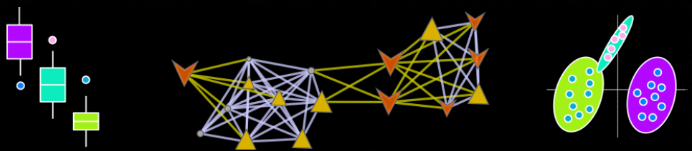
Omic Data Analysis Workflow
Dmitry Grapov, PhD
CDS- Creative Data Solutions

Slide 2
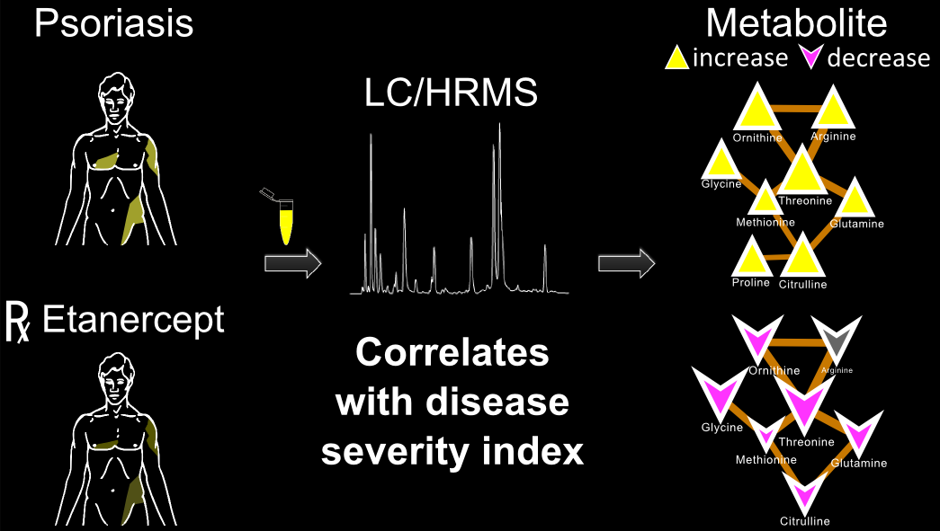
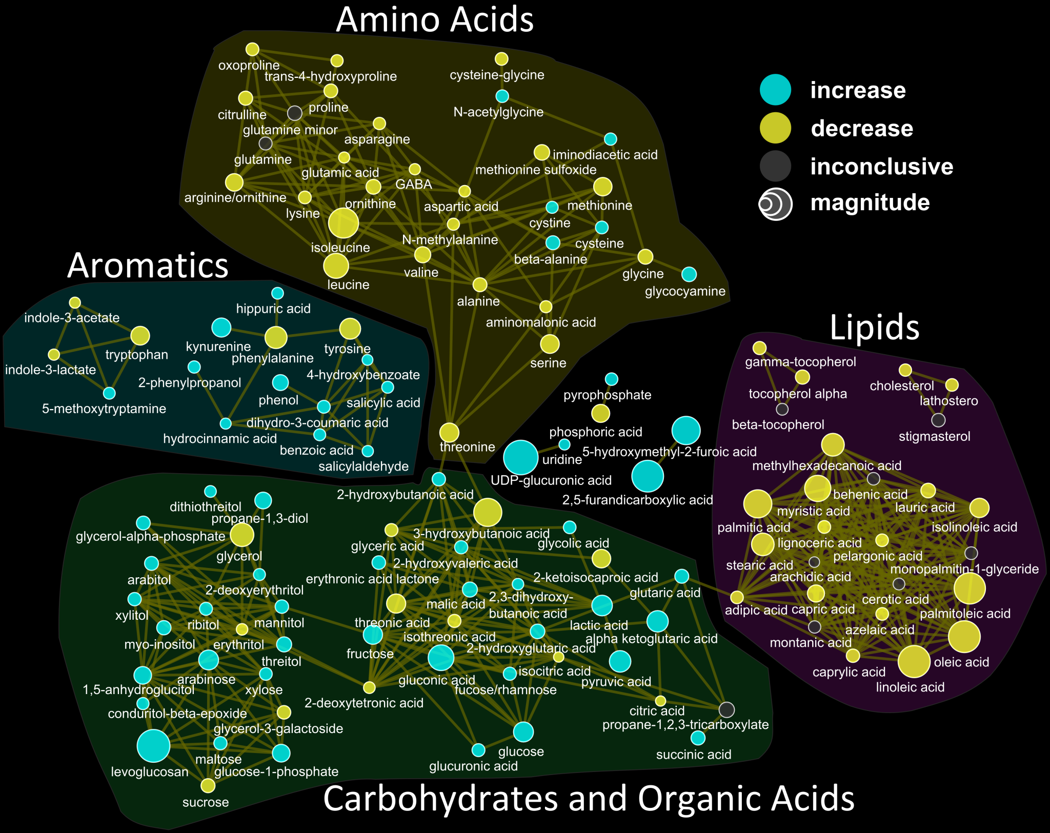
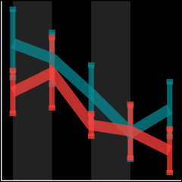
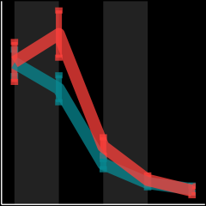
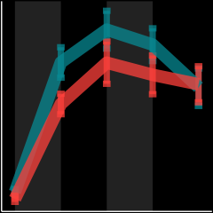
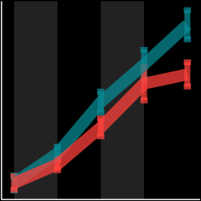
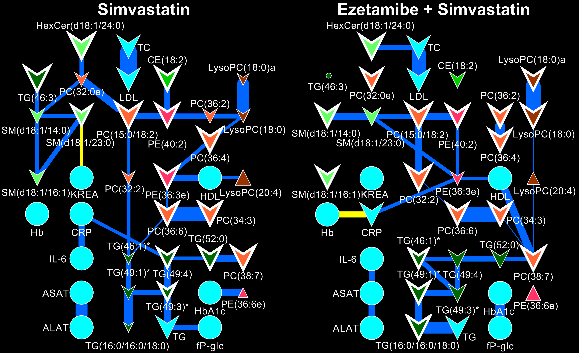
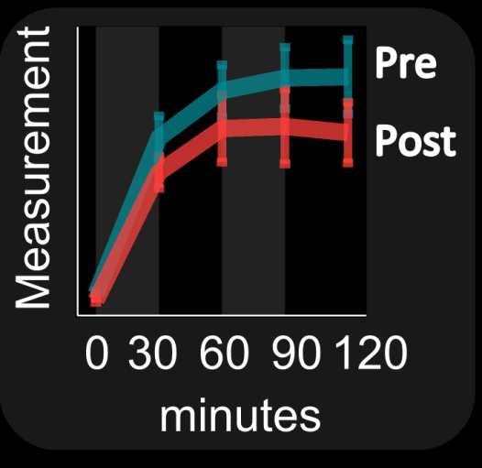
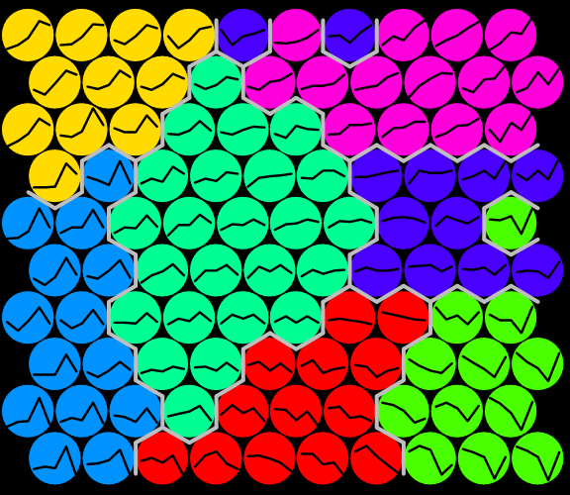
data analysis and visualization
Biomarker validation
Multivariate Modeling
Metabolomics can offer real-time insight into treatment efficacy and drive personalized medicine decisions
J. Proteome Res., 2015, 14 (1), pp 557–566 DOI: 10.1021/pr500782g
Network Analysis
Grapov et. al., Circ. Cardiovasc. Genet. 2014
Grapov et. al.,PLoS ONE (2014) doi:10.1371/journal.pone.0084260

Slide 3
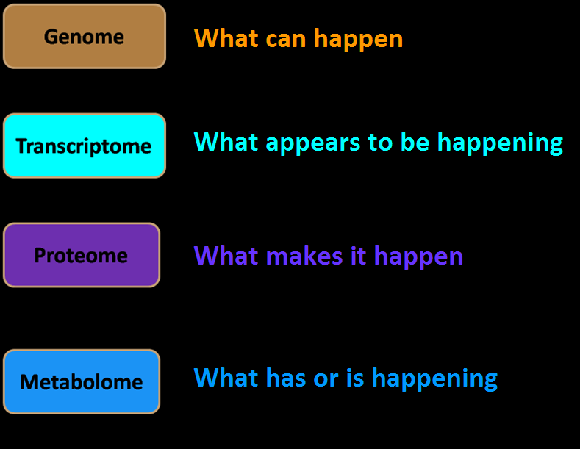
Metabolomics: study of small molecules

Slide 4
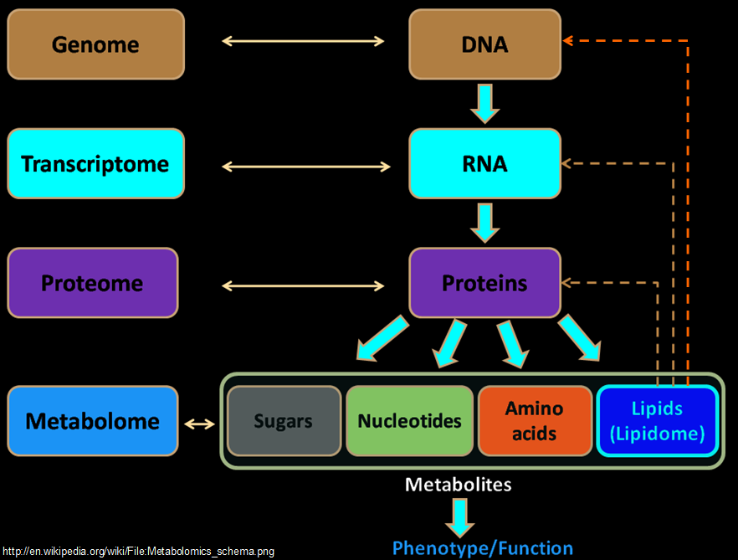
Metabolome: a proxy for phenotype

Slide 5
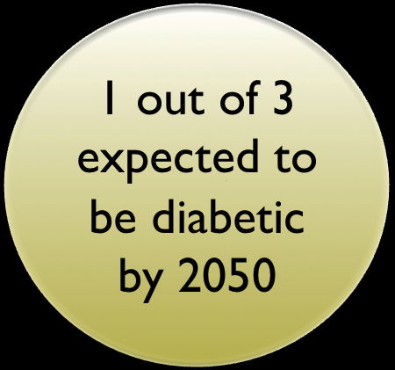


Need for Integromics
Type 2 Diabetes
2009
Many diseases, including aging, have dominant metabolic components (e.g. metabolic syndrome)
~10% variance explained
Genotype +
metabolome
>40% variance
explained
PMID:24204828

Slide 6
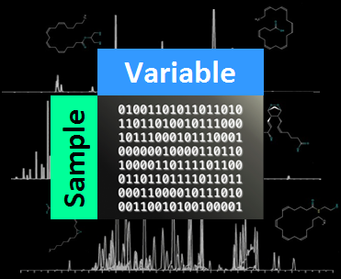

Example:
Proteomic and metabolomic data analysis
exploratory analysis
statistical analysis
predictive modeling
functional analysis
Follow along:
report/report.md
View Code:
report/report.Rmd
https://github.com/dgrapov/TeachingDemos/blob/master/Demos/Data%20Analysis%20Workflow/

Slide 7
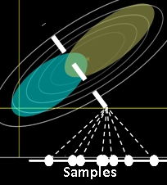


Projection of Data
The algorithm defines the position of the light source
Principal Components Analysis (PCA)
unsupervised
maximize variance (X)
Partial Least Squares Projection to Latent Structures (PLS)
supervised
maximize covariance (Y ~ X)
PC1
PC2
James X. Li, 2009, VisuMap Tech.

Slide 8
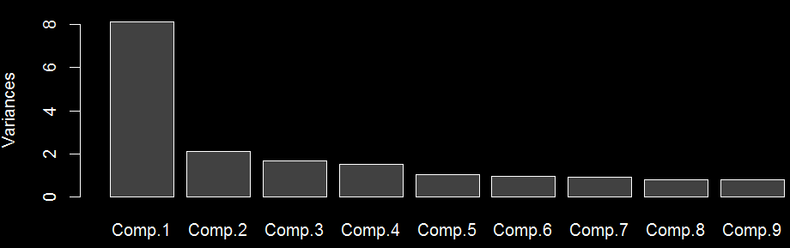
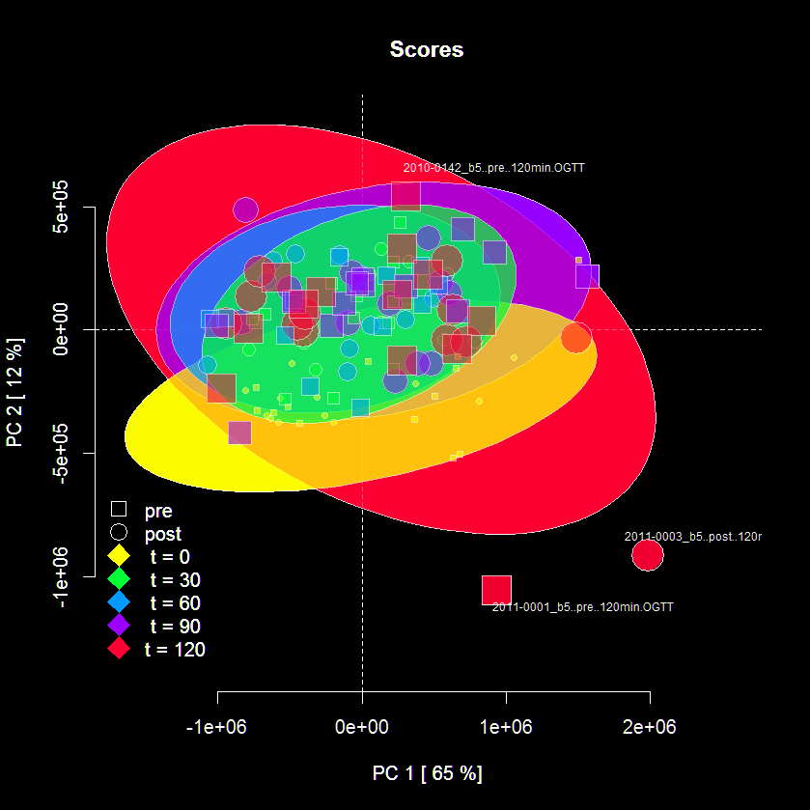
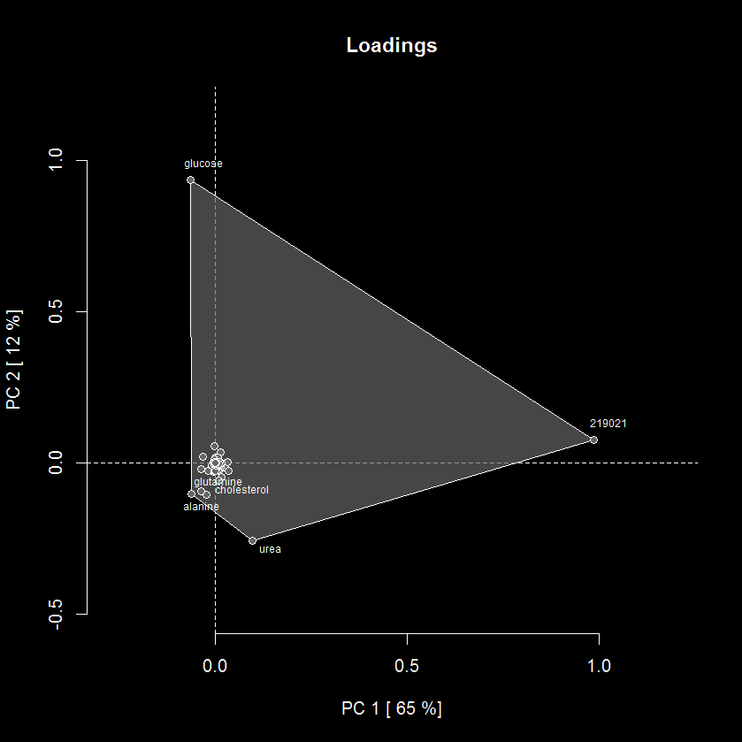
Interpreting PCA Results
Variance explained (eigenvalues) Row (sample) scores and column (variable) loadings

Slide 9
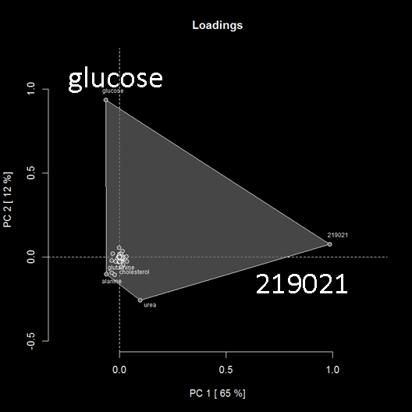
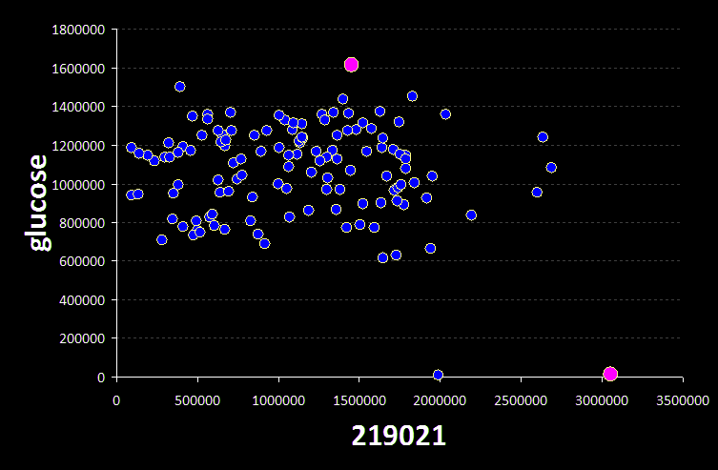
How are scores and loadings related?
1/3:

